Slide 1
PESU I/O ML PROJECT
- Nidhi Gupta
PES2201900392

Slide 2
INTRODUCTION

Slide 3
LOGISTIC REGRESSION

Slide 4
LOGISTIC REGRESSION vs LINEAR REGRESSION
Logistic regression predicts categorical outcomes (binomial/multinomial values of y), whereas linear Regression is good for predicting continuous-valued outcomes (such as the weight of a person in kg, the amount of rainfall in cm).

Slide 5
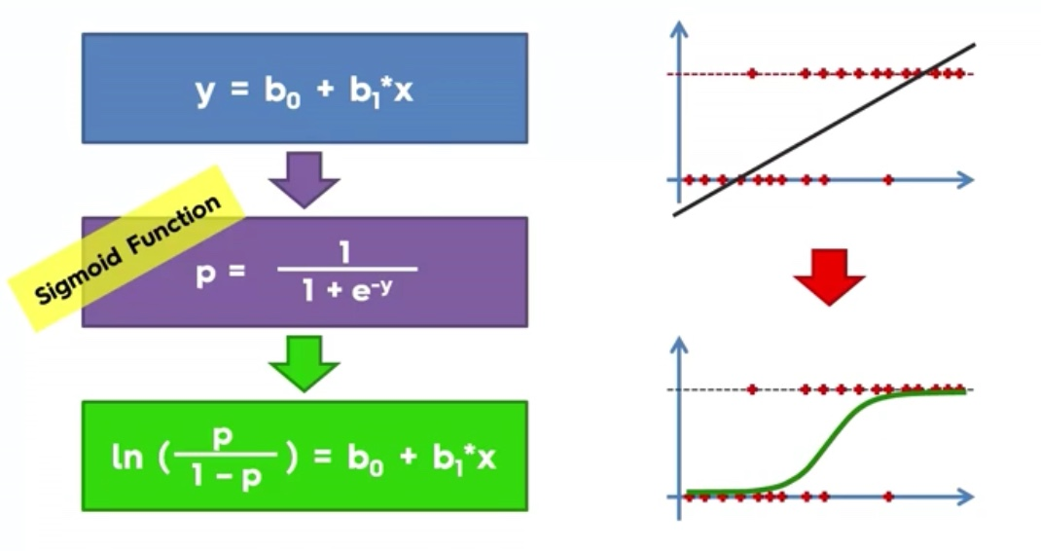

Slide 6
LOGISTIC REGRESSION ASSUMPTIONS
Logistic Regression is a linear model.
Binary logistic regression requires the dependent variable to be binary and ordinal logistic regression requires the dependent variable to be ordinal.
Logistic regression requires the observations to be independent of each other. In other words, the observations should not come from repeated measurements or matched data.
Logistic regression requires there to be little or no multicollinearity among the independent variables. This means that the independent variables should not be too highly correlated with each other.
Logistic regression assumes linearity of independent variables and log odds. Although this analysis does not require the dependent and independent variables to be related linearly, it requires that the independent variables are linearly related to the log odds.
Note: Logistic Regression can be used for as many independent variables as we want. However we should be aware that we won’t be able to visualize the results in more than 3 dimensions.

Slide 7
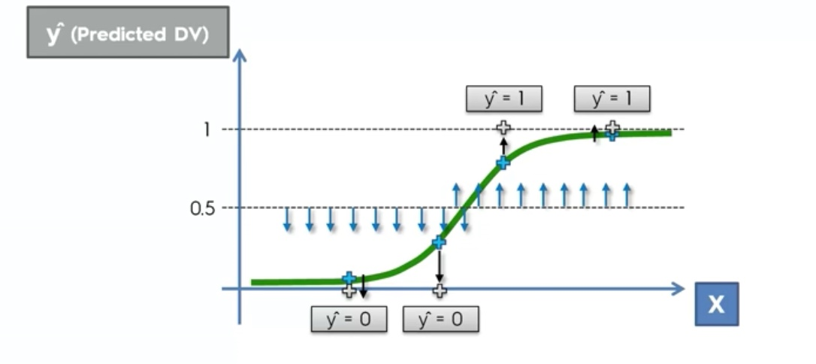

Slide 8
PROJECT

Slide 9
ADVANTAGES:
It is a widely used technique because it is very efficient, does not require too many computational resources, it’s highly interpretable, it doesn’t require input features to be scaled, it doesn’t require any tuning, it’s easy to regularize, and it outputs well-calibrated predicted probabilities.
Because of its simplicity and the fact that it can be implemented relatively easy and quick, Logistic Regression is also a good baseline that you can use to measure the performance of other more complex Algorithms.
DISADVANTAGES:
Logistic Regression is also not one of the most powerful algorithms out there and can be easily outperformed by more complex ones.
We can’t solve non-linear problems with logistic regression since it’s decision surface is linear.
Logistic regression will not perform well with independent variables that are not correlated to the target variable and are very similar or correlated to each other.

Slide 10
HOW PESU I/O HELPED ME

Slide 11
THANK YOU

